Slide 1
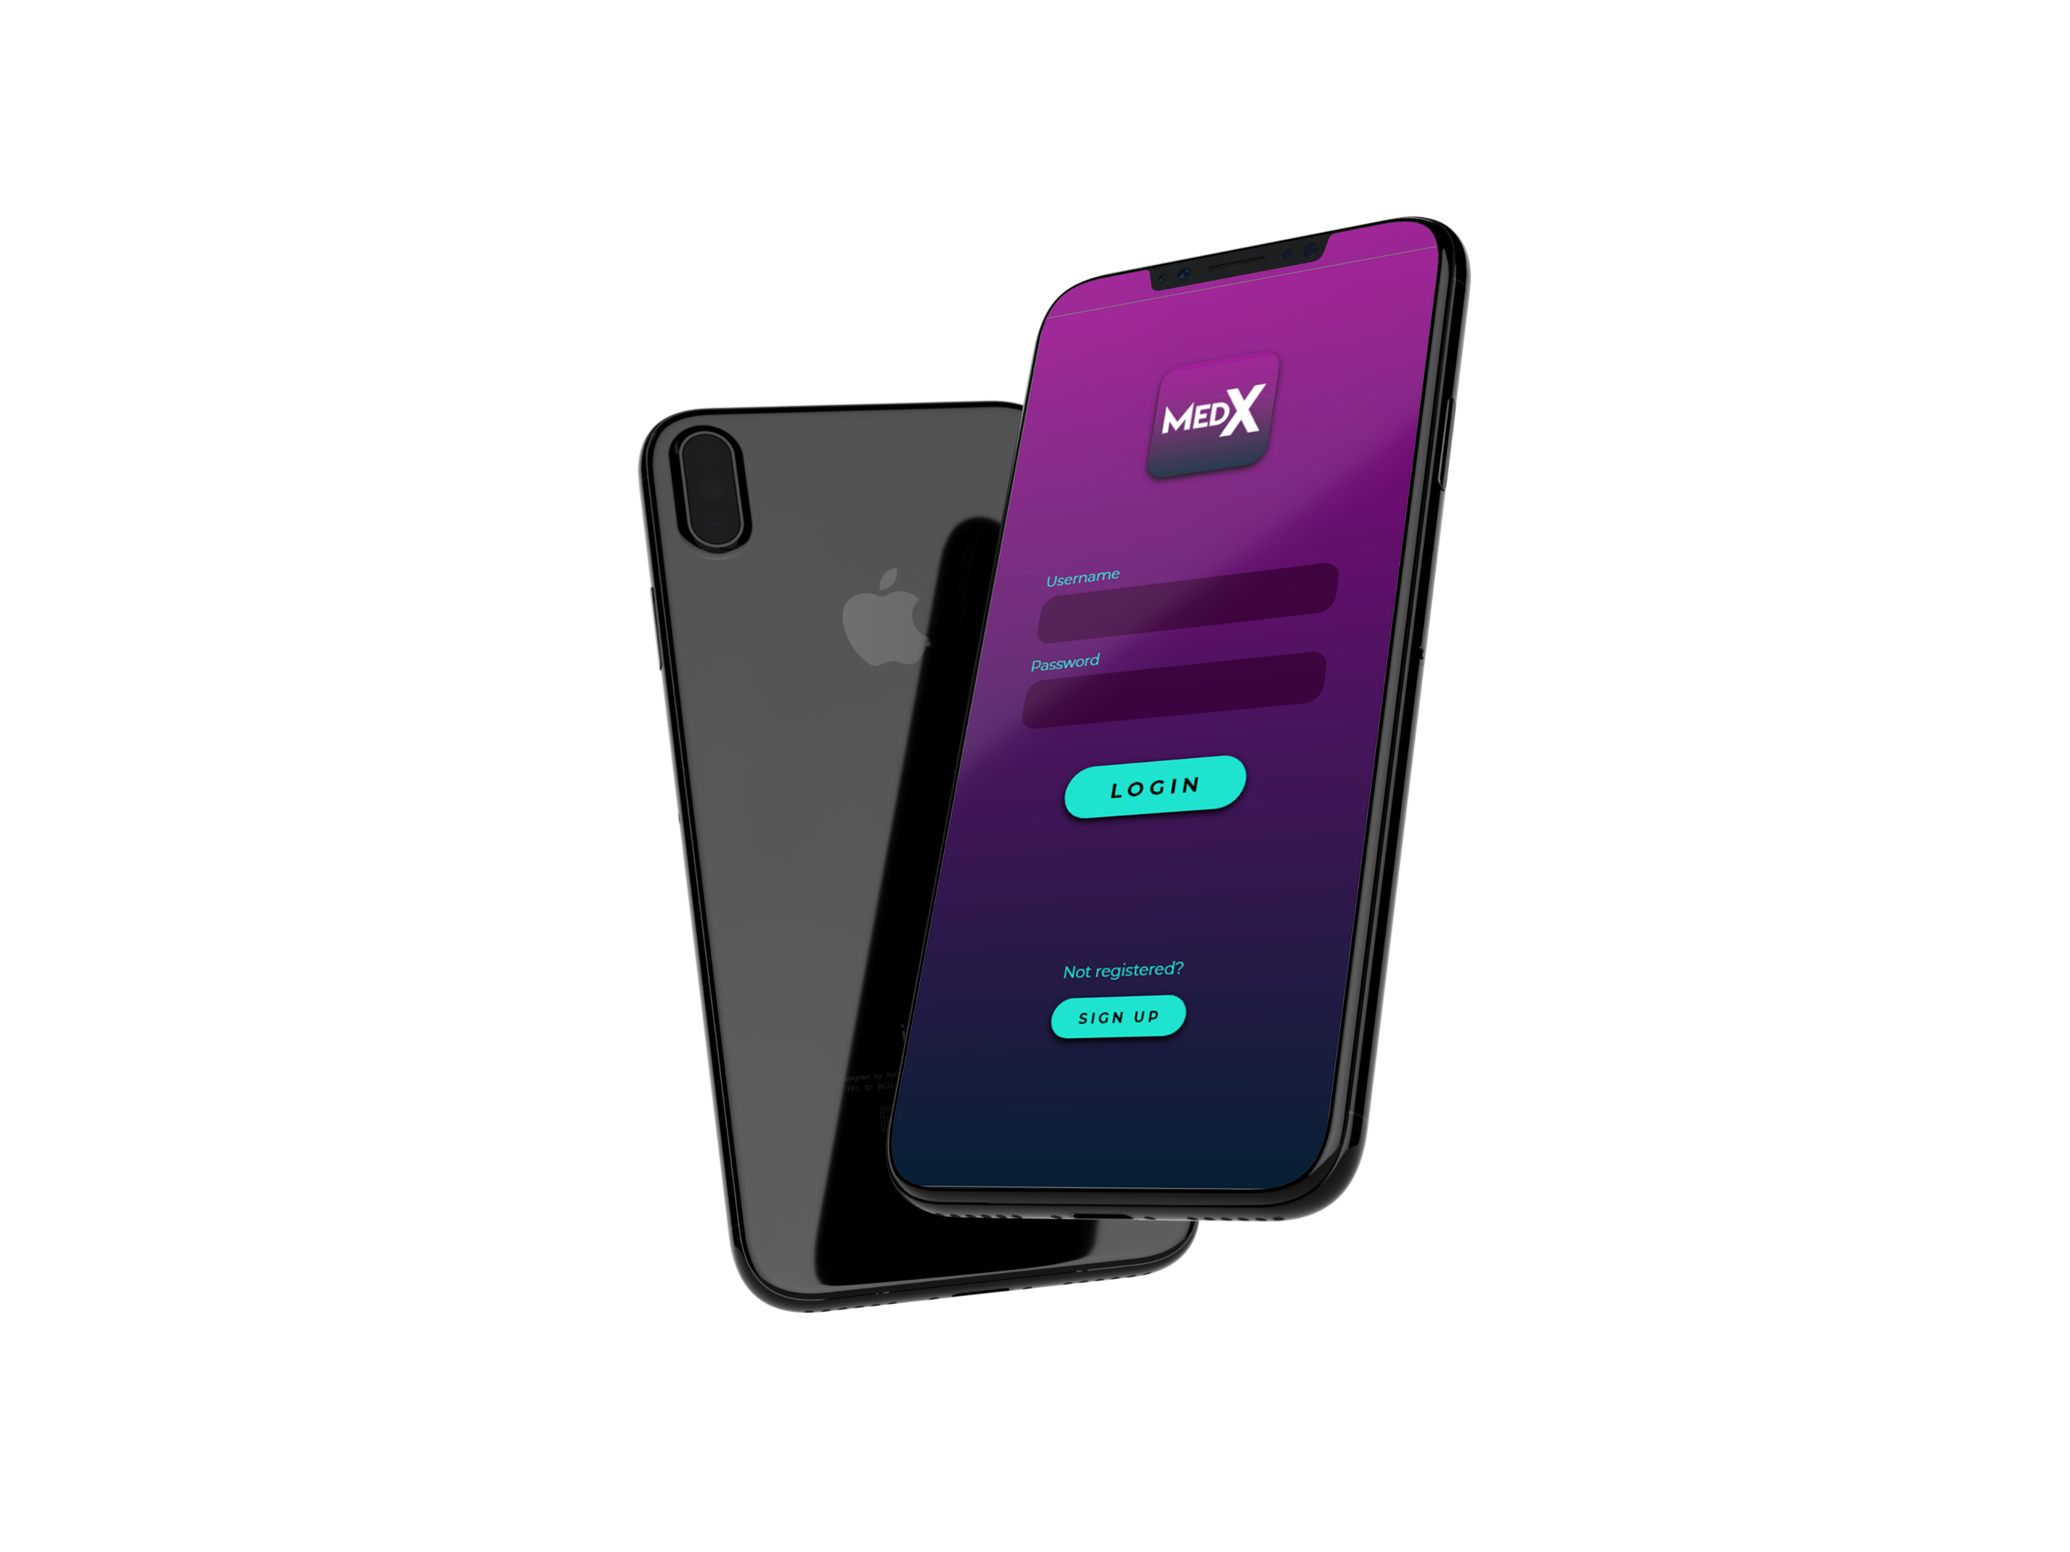
MEDX
TEAM HACKX

Slide 2
ABOUT US
ADVYTH ASHOK
Amritha, Kochi
R PRAVEEN PAI
Amritha, Kochi
TEAM HACKX
AHAMMED IRSHAD
CUSAT, Kochi
JOEL JOHN
AJCE, Kanjirappally

Slide 3


Slide 4
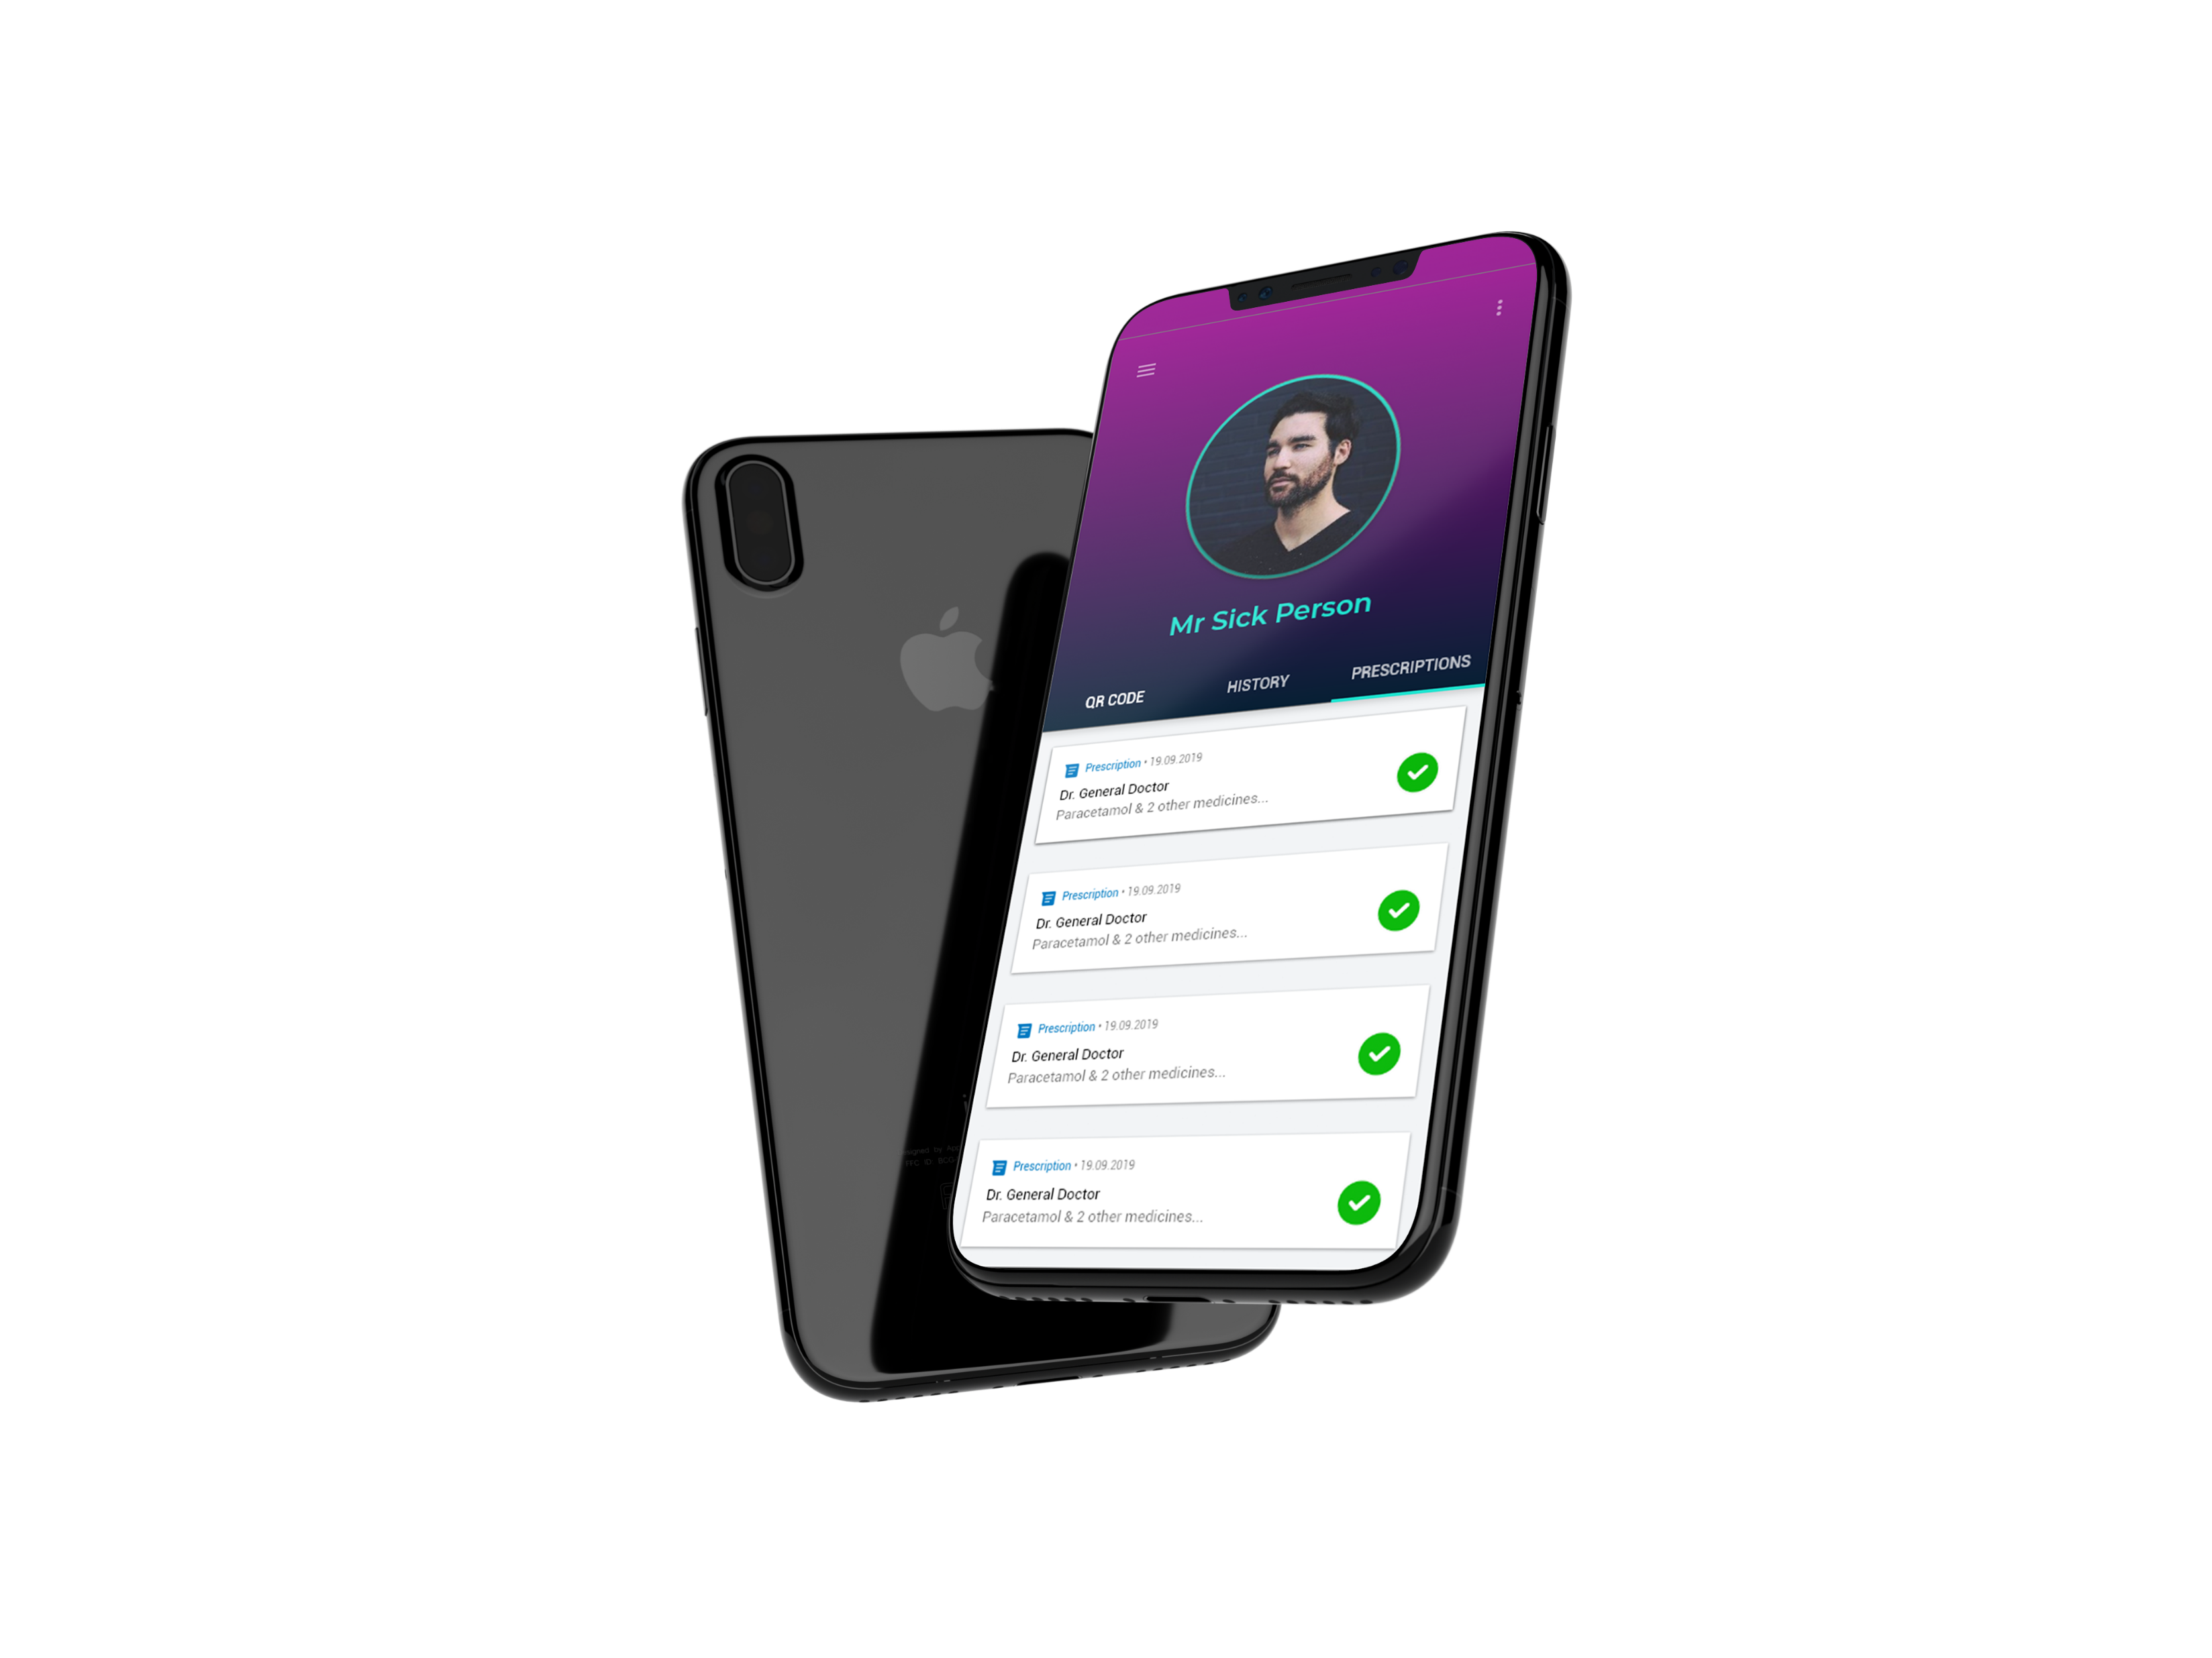
PROBLEM
Forgery of Prescription

Slide 5
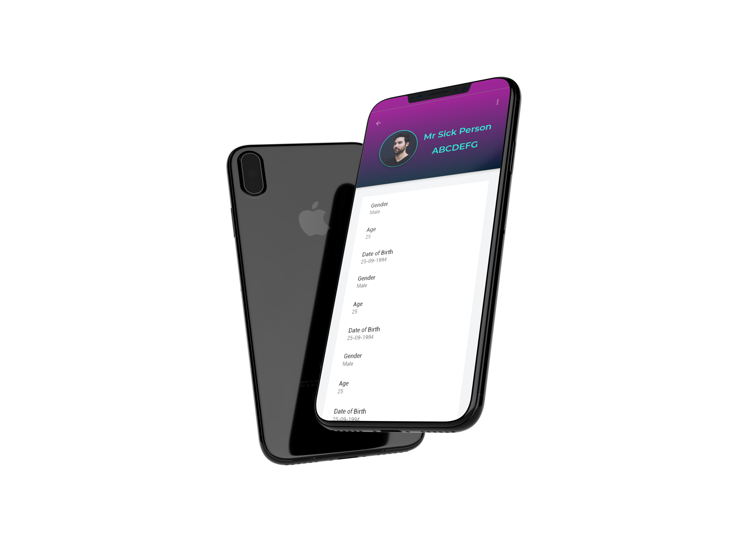
“Some customers resist such marking, which is a clear indication of their dubious intent. But if the prescription itself is forged, then nothing can be done. Besides, delaying the issue of drugs for verification with the doctor in the event of suspicion often raises hackles of genuine customers, which ultimately hamper our business,” - PV.Tomy.

Slide 6
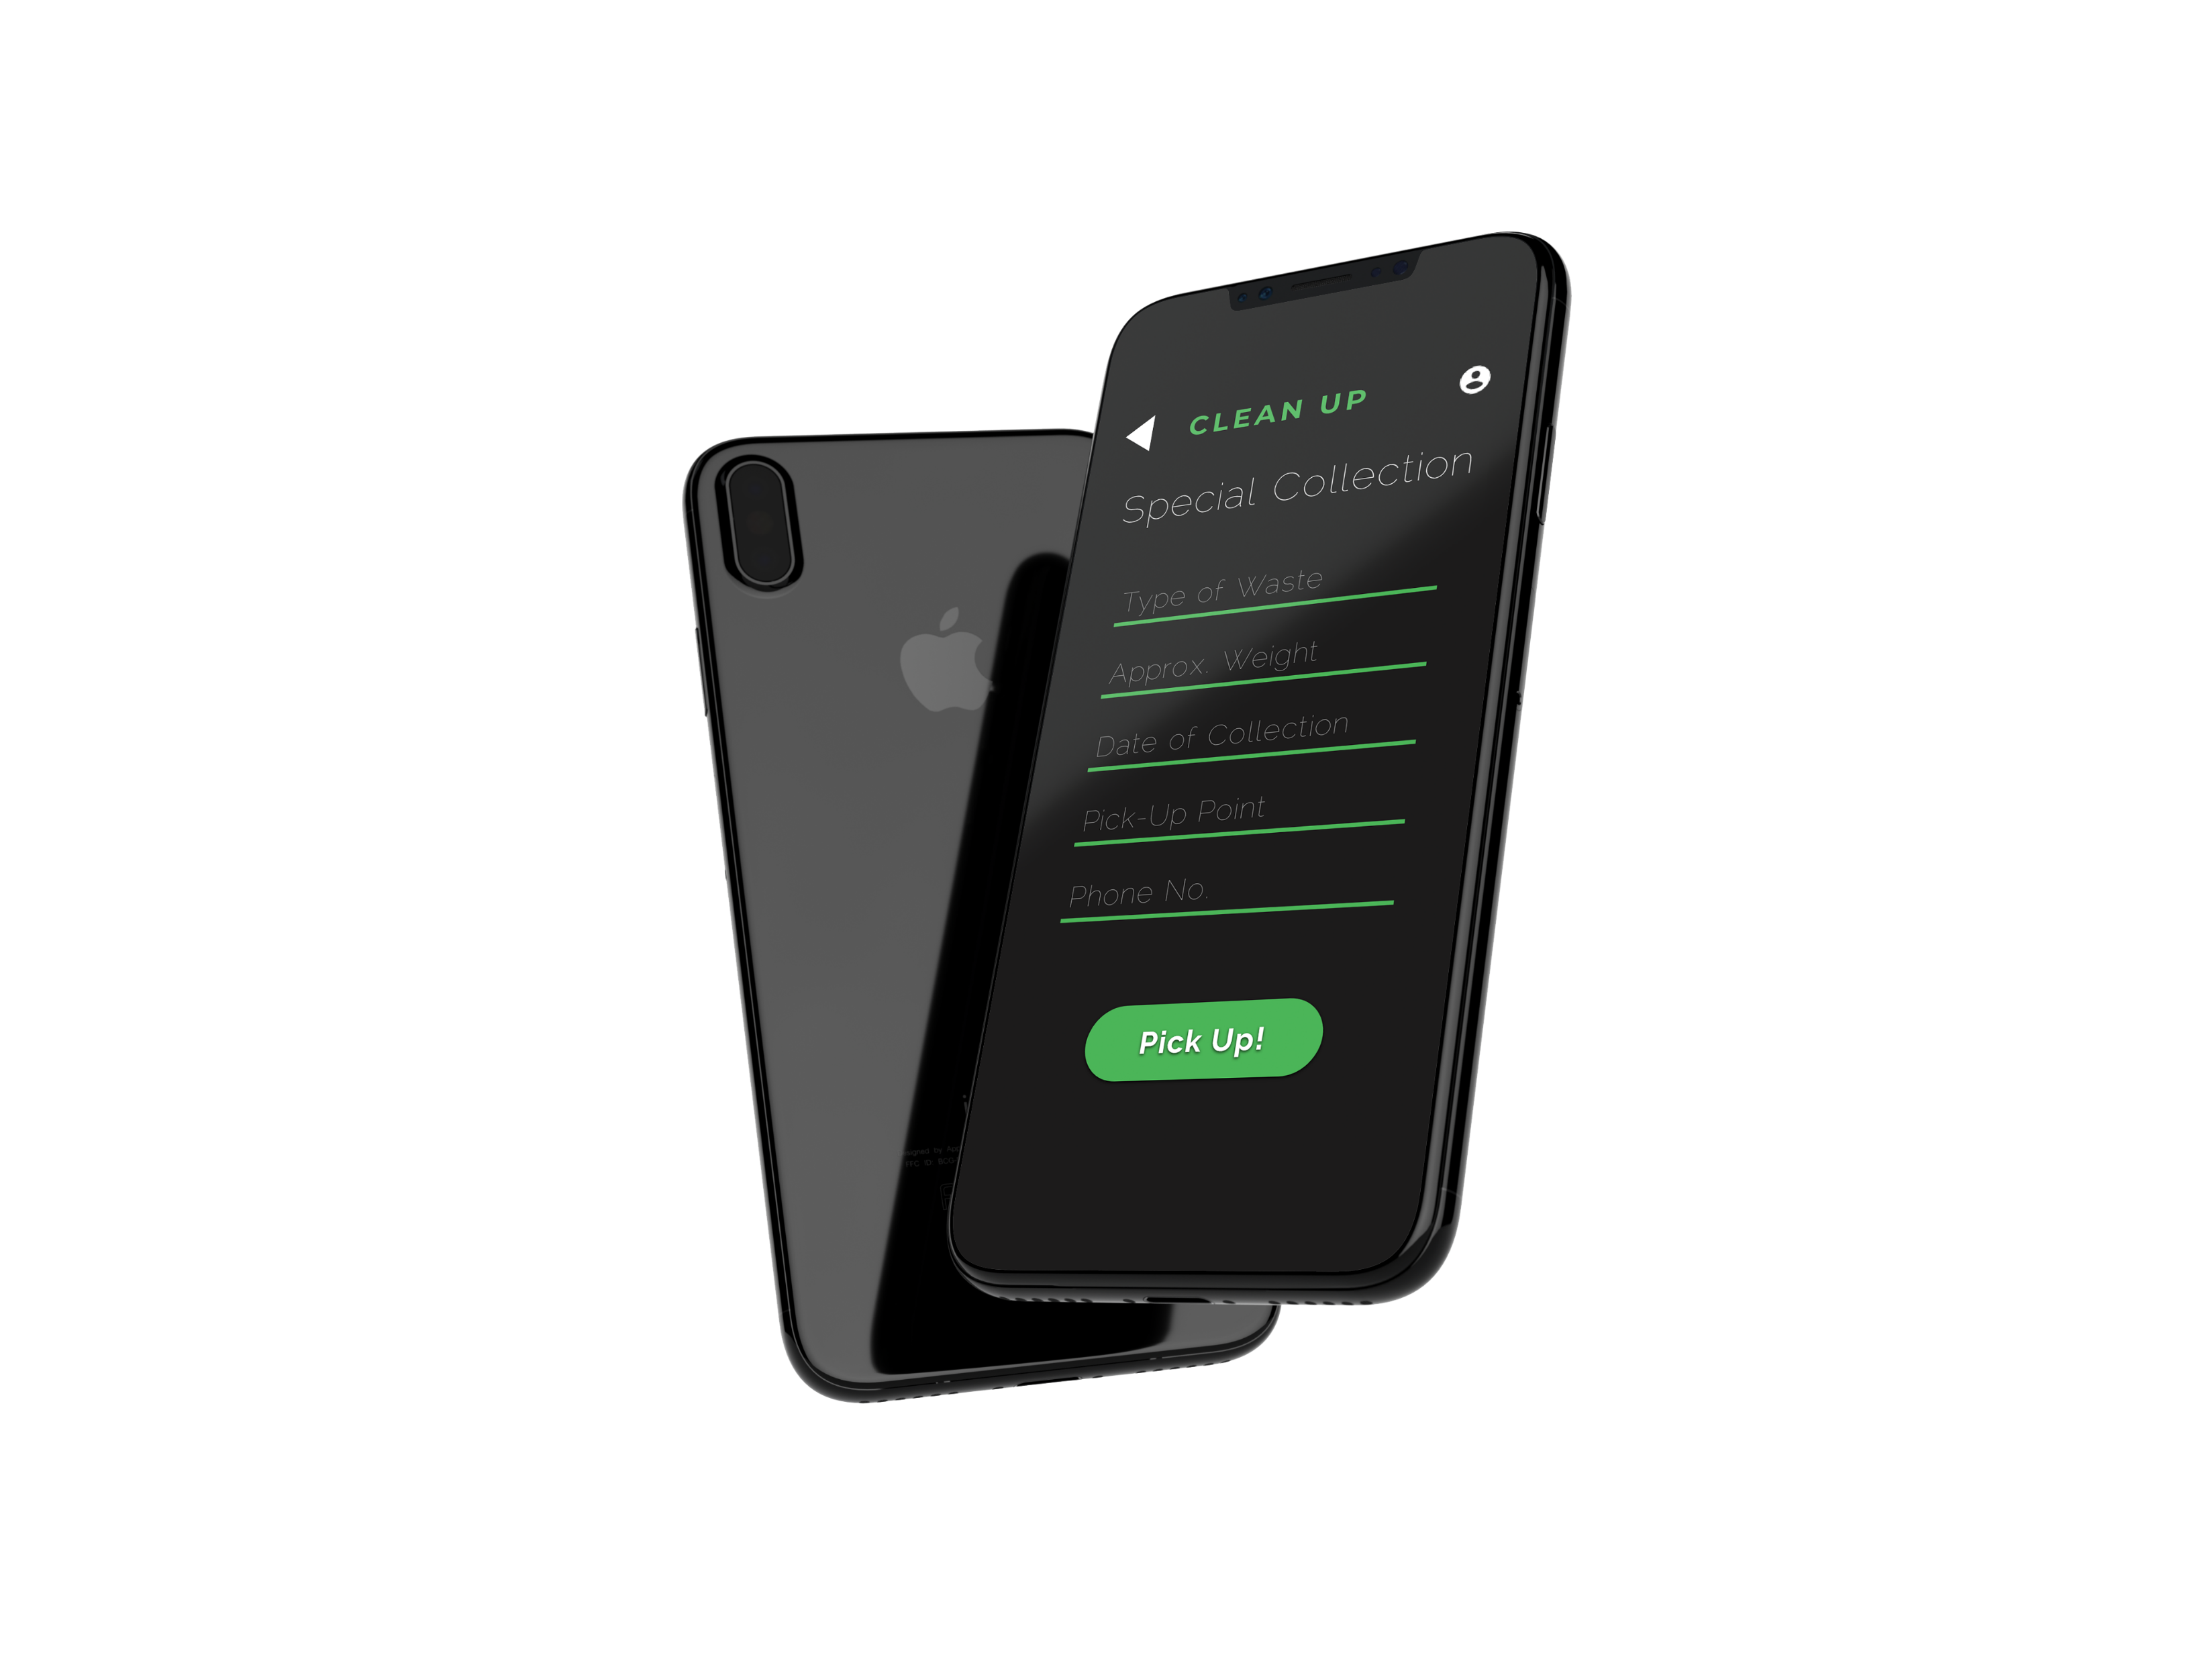
SOLUTION
A Verifiable Prescription System that connects hospital to the pharmacists without much involvement of the patient.

Slide 7

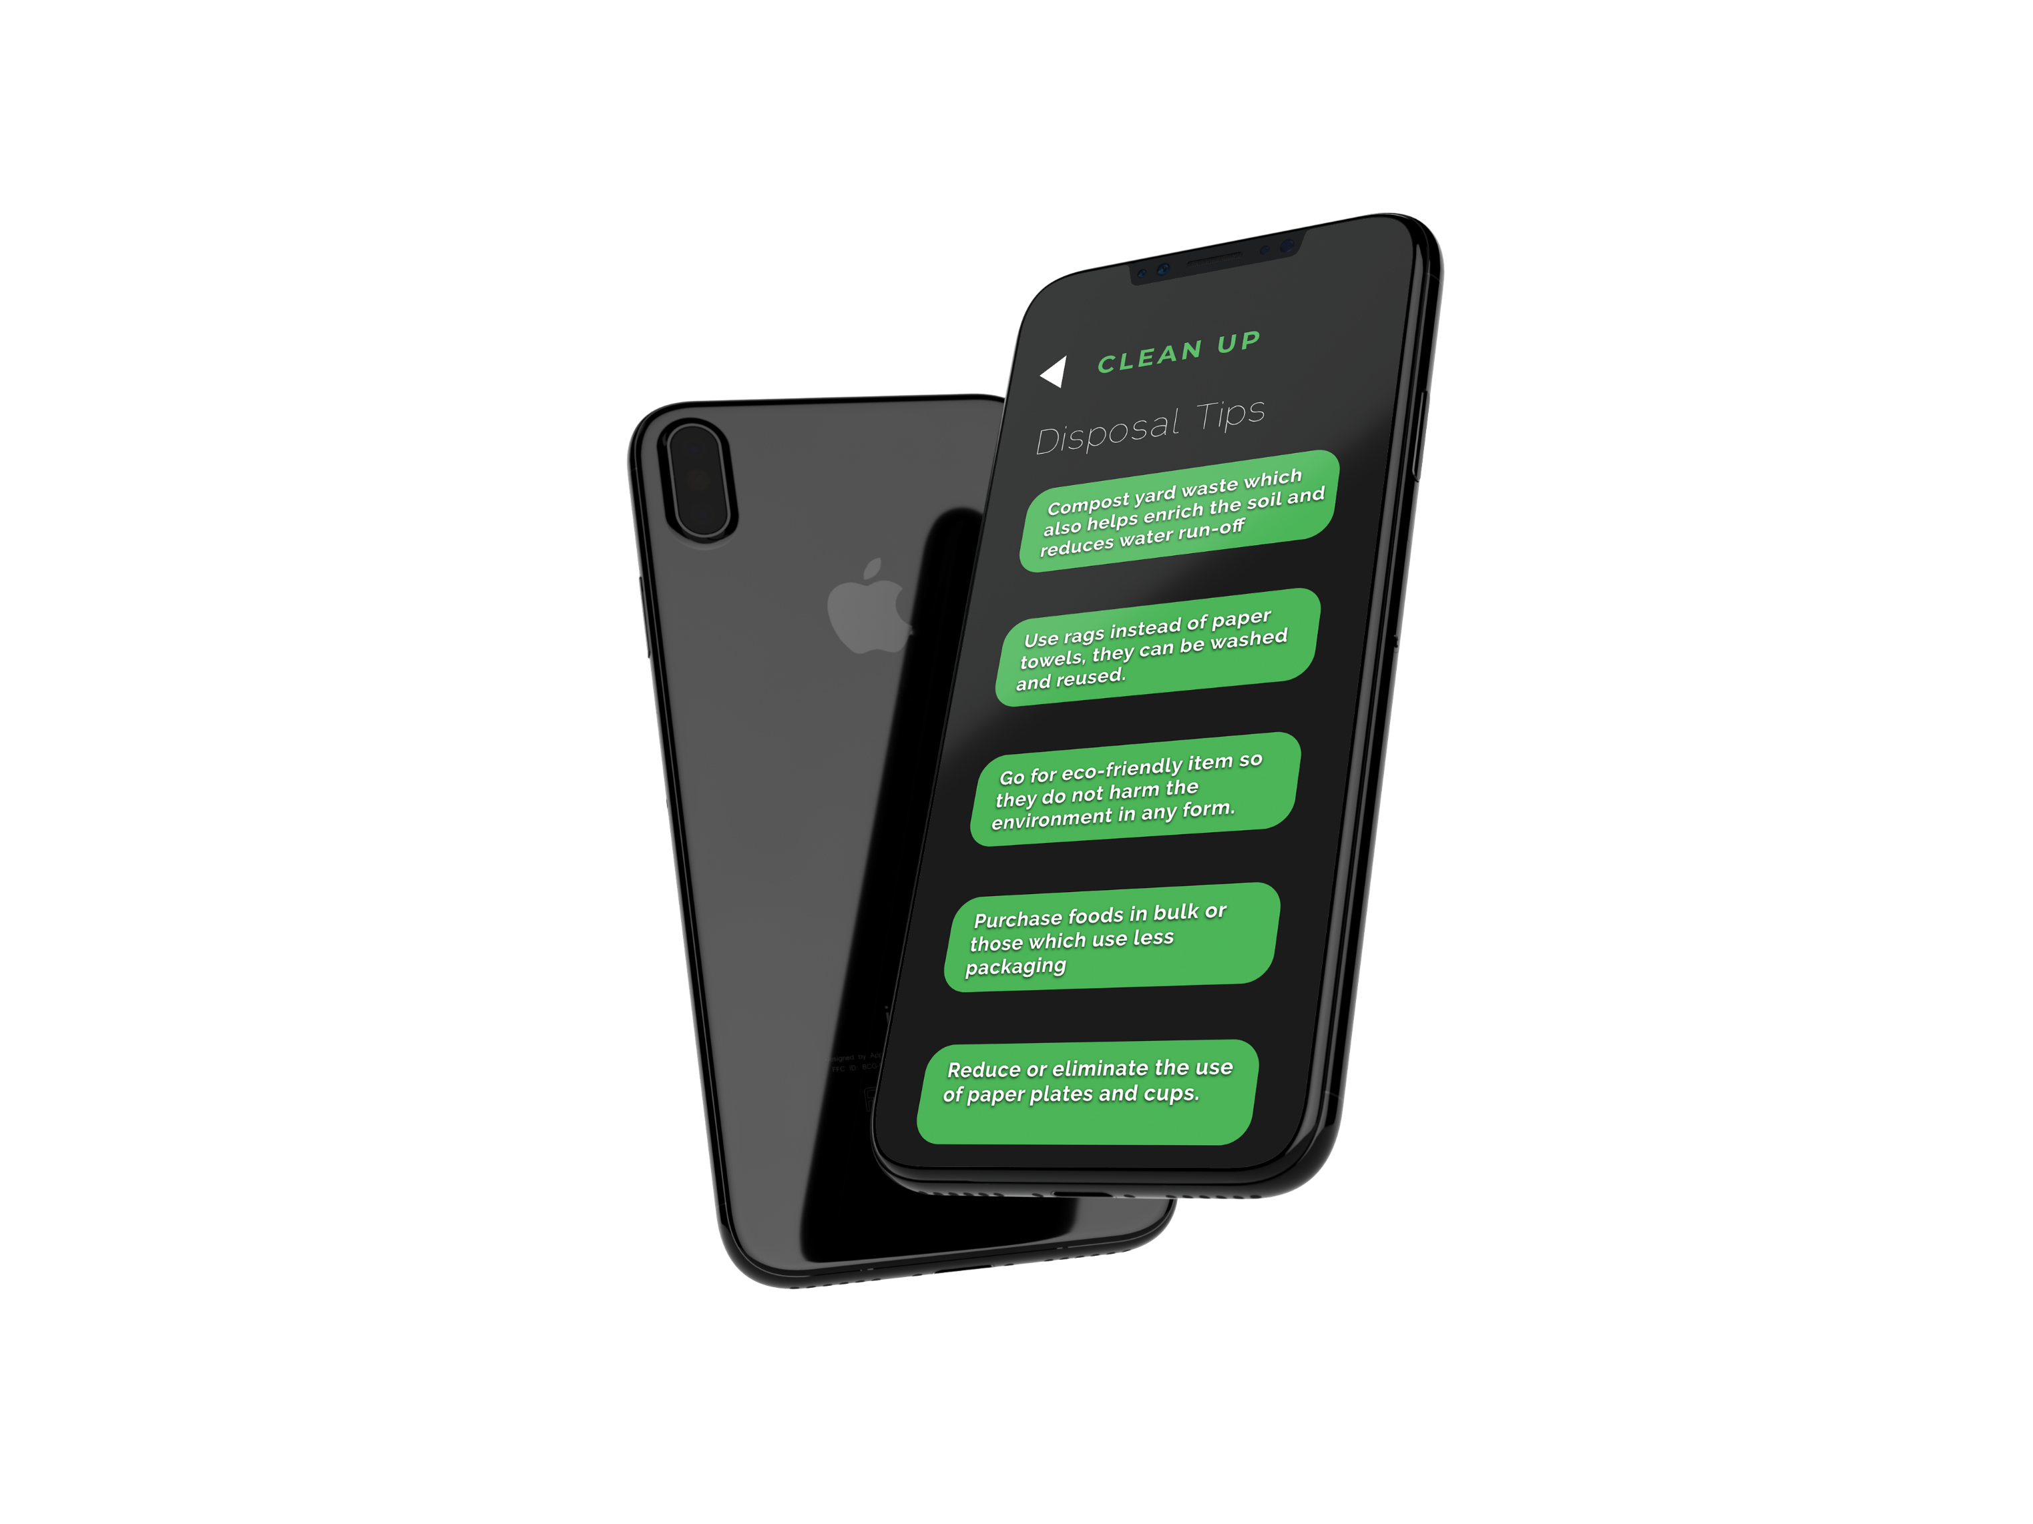
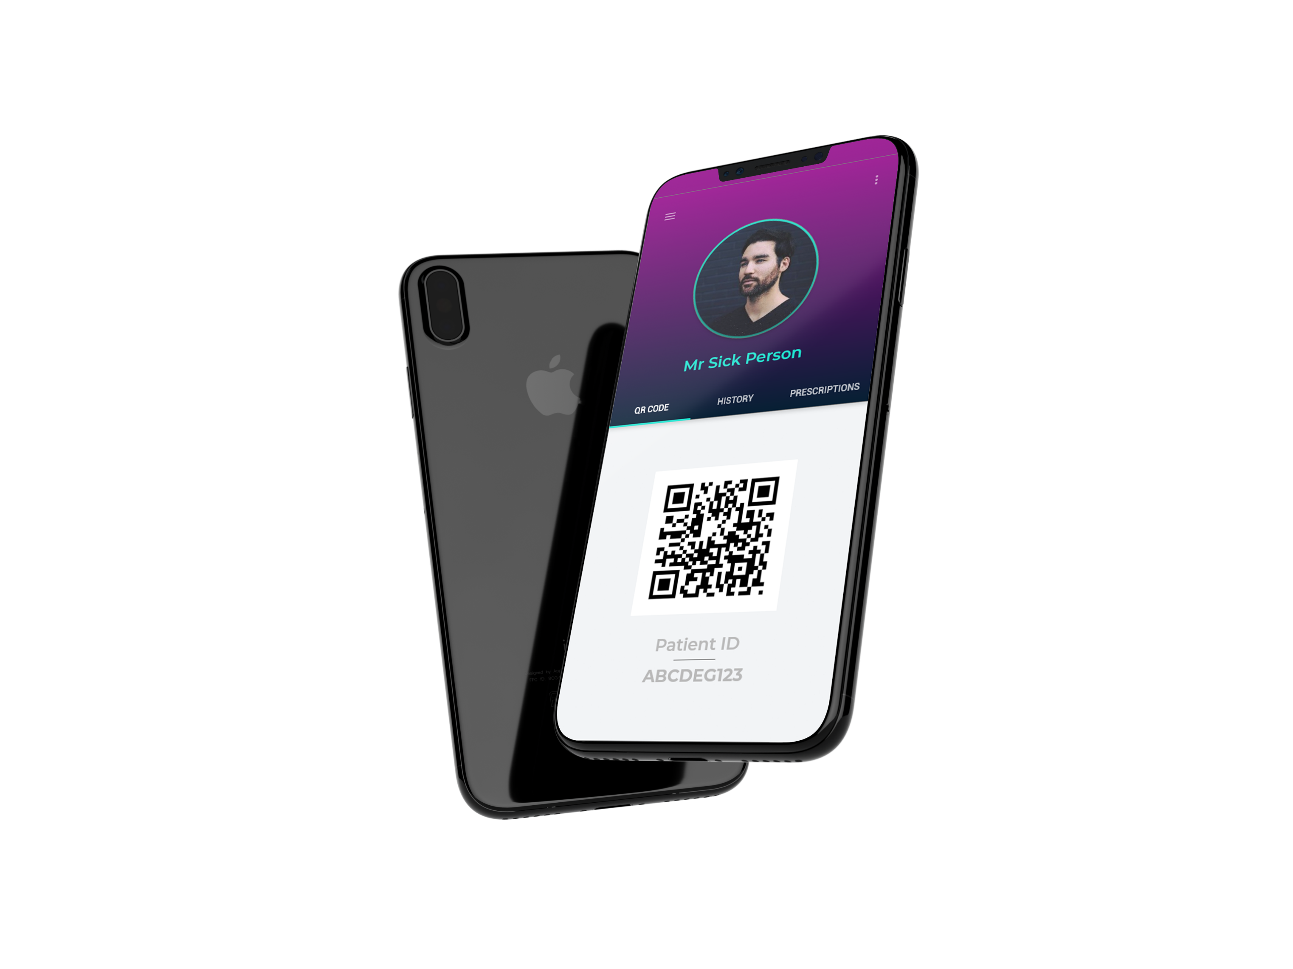
OUR REVENUE MODEL
MedX is a B2B SAAS
A service based model wherein we provide both the hospitals and the pharmacists with our web app for a monthly fee.

Slide 8
THANK YOU!
TEAM HACKX

